Slide 1
Lessons Learned From Agile Quality Assurance In Scrum

Slide 2
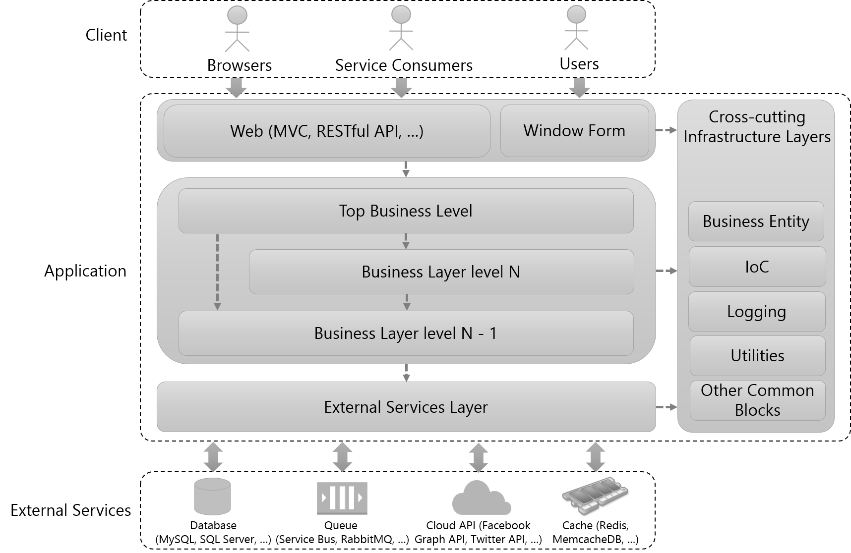
The conceptual structure of an application to software testing

Slide 3
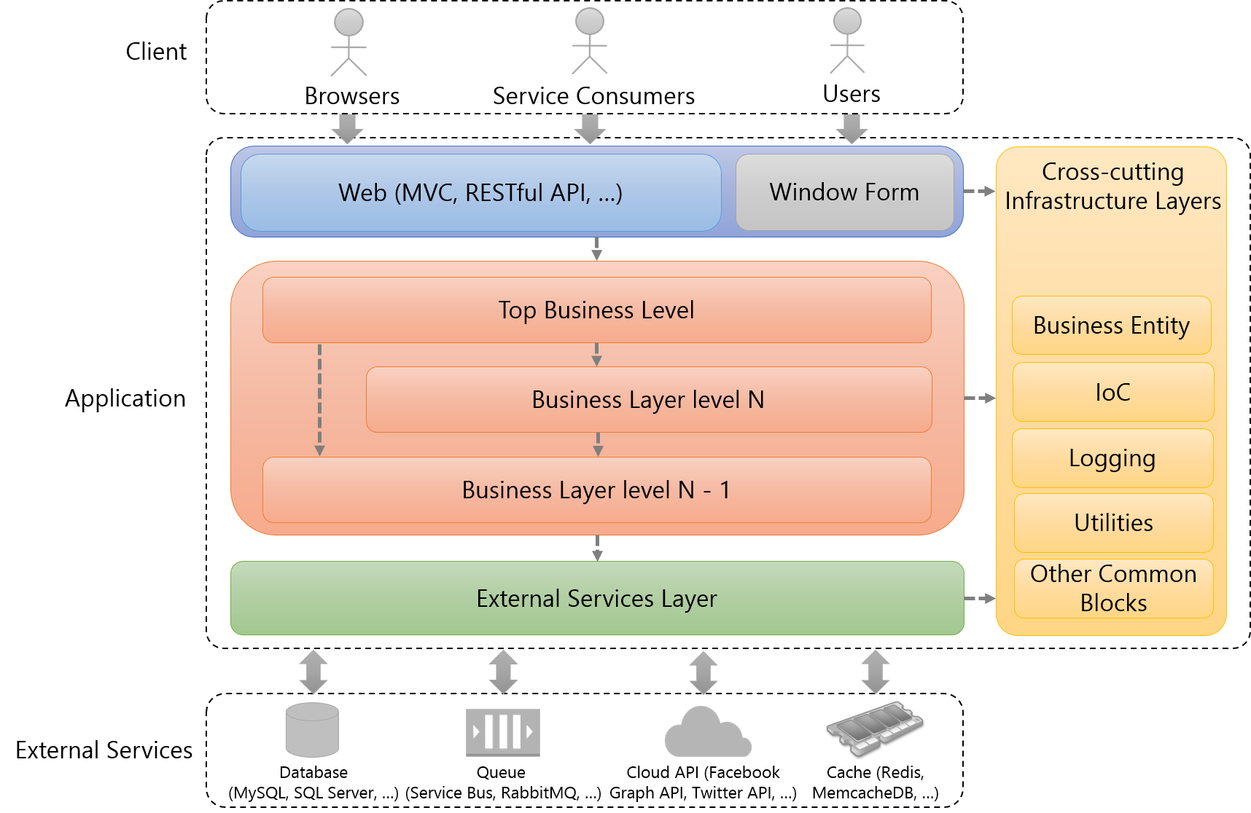
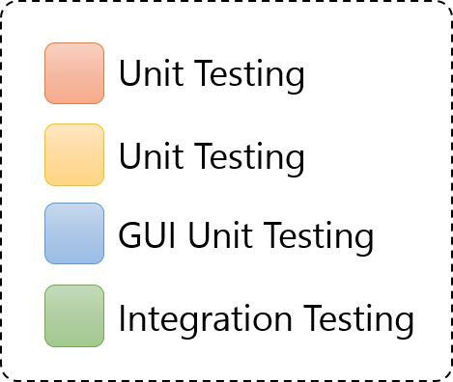
The conceptual structure of an application to software testing
Software components are covered by types of testing

Slide 4
The conceptual structure of an application to software testing
System Testing
Automated System Testing
Manual System Testing
End-To-End Testing
Integration Testing

Slide 5


The conceptual structure of an application to software testing
End-To-End Testing
System Integration Testing
Simulate real user scenarios to test the entire application.
Call the top business level to test the application.
The entire application is tested for critical functionalities.
Only business logic is tested for critical functionalities.

Slide 6
DEMO

Slide 7
What types of testing should be applied to a project in Scrum?
Unit Testing
GUI Unit Testing
Integration Testing
System Testing (Manual System Testing, Automated System Testing)

Slide 8
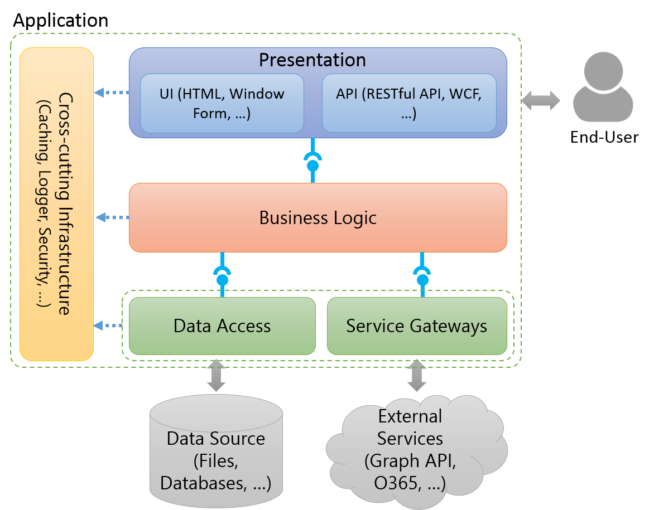
The conceptual structure of an application to software testing
Notes:
To talk something about the conceptual structure of an application to show to audiences the structure which is applied in almost applications.

Slide 9
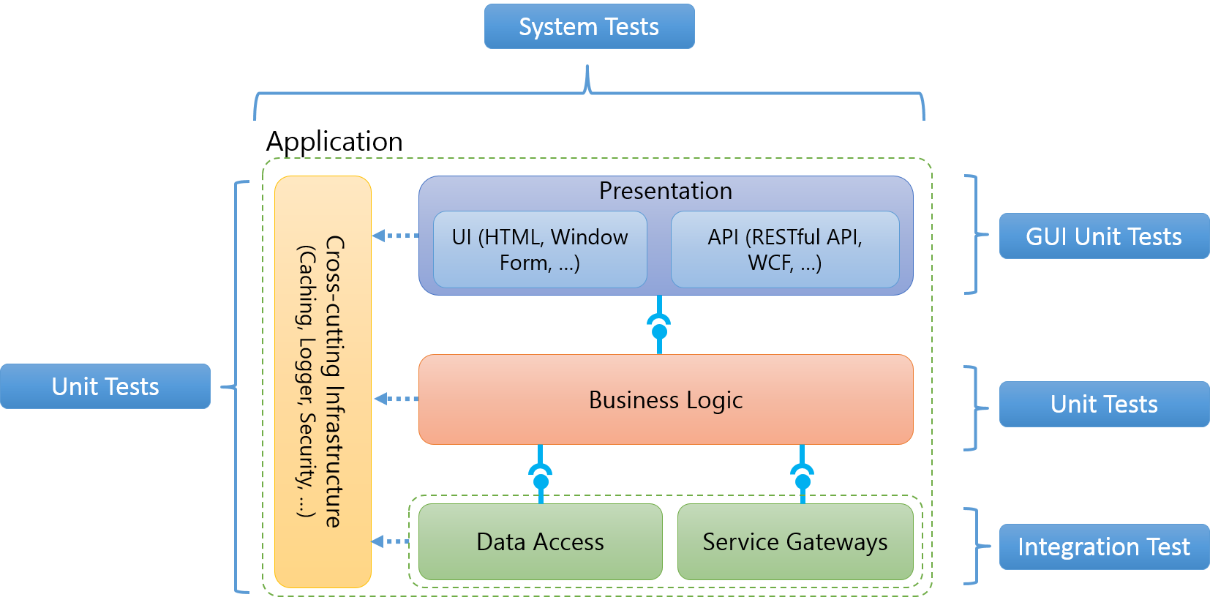
The conceptual structure of an application to software testing
Notes:
To indicate what aspects of an application are covered which types of test (Ex: Business Logic is covered by unit tests.)

Slide 10

Application
Cross-cutting Infrastructure
(Caching, Logger, Security, …)
Presentation
UI (HTML, Window Form, …)
API (RESTful API, WCF, …)
End-User
Business Logic
Data Access
Service Gateways
Data Source (Files, Databases, …)
External Services (Graph API, O365, …)

Slide 11
System Tests
Application
Cross-cutting Infrastructure
(Caching, Logger, Security, …)
Presentation
UI (HTML, Window Form, …)
API (RESTful API, WCF, …)
GUI Unit Tests
Unit Tests
Business Logic
Unit Tests
Data Access
Service Gateways
Integration Test
Notes:
http://blogs.msdn.com/b/jmeier/archive/2008/11/24/application-architecture-diagrams-added-to-codeplex.aspx

Slide 12




Client
Browser
Web Server
Business Entity
Presentation
Cross-cutting Infrastructure
UI (MVC, Window Form, …)
API (RESTful API, WCF, …)
Configuration
Business Logic
Logging
Utilities
Service Gateways
Other Common Blocks
Database
(Cassandra, MongoDb, …)
Queue
(Service Bus, RabbitMQ, …)
Cloud API (Facebook Graph API, Twitter API, …)
Memcache (Redis, MemcacheDB, …)
Notes:
http://blogs.msdn.com/b/jmeier/archive/2008/11/24/application-architecture-diagrams-added-to-codeplex.aspx

Slide 13


Client
Browsers
Service Consumers
Users
Web (MVC, RESTful API, …)
Window Form
Cross-cutting Infrastructure Layers
Top Business Level
Business Entity
Application
Business Layer level N
IoC
Logging
Business Layer level N - 1
Utilities
External Services Layer
Other Common Blocks
External Services
Database
(MySQL, SQL Server, …)
Queue
(Service Bus, RabbitMQ, …)
Cloud API (Facebook Graph API, Twitter API, …)
Cache (Redis, MemcacheDB, …)

Slide 14
Client
Browsers
Service Consumers
Users
Web (MVC, RESTful API, …)
Window Form
Cross-cutting Infrastructure Layers
Top Business Level
Business Entity
Application
Business Layer level N
IoC
Logging
Business Layer level N - 1
Utilities
External Services Layer
Other Common Blocks
External Services
Database
(MySQL, SQL Server, …)
Queue
(Service Bus, RabbitMQ, …)
Cloud API (Facebook Graph API, Twitter API, …)
Cache (Redis, MemcacheDB, …)

Slide 15
Unit Testing
Unit Testing
GUI Unit Testing
Integration Testing

Slide 16
Simulate real user scenarios to test the entire application.
Client
Browsers
Service Consumers
Users
Web (MVC, RESTful API, …)
Window Form
Cross-cutting Infrastructure Layers
Top Business Level
Business Entity
Application
Business Layer level N
IoC
Logging
Business Layer level N - 1
Utilities
External Services Layer
Other Common Blocks
External Services
Database
(MySQL, SQL Server, …)
Queue
(Service Bus, RabbitMQ, …)
Cloud API (Facebook Graph API, Twitter API, …)
Cache (Redis, MemcacheDB, …)

Slide 17
Client
Browsers
Service Consumers
Users
Web (MVC, RESTful API, …)
Window Form
Cross-cutting Infrastructure Layers
Top Business Level
Business Entity
Application
Business Layer level N
IoC
Logging
Business Layer level N - 1
Utilities
External Services Layer
Other Common Blocks
External Services
Database
(MySQL, SQL Server, …)
Queue
(Service Bus, RabbitMQ, …)
Cloud API (Facebook Graph API, Twitter API, …)
Cache (Redis, MemcacheDB, …)

Slide 18
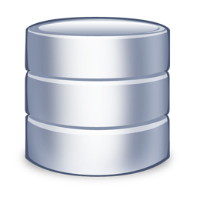
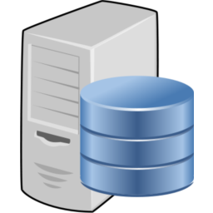

Source Repository
Build Server
Development Machine

